Slide 1
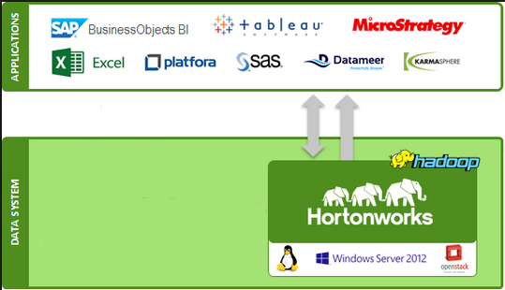
BI on Hadoop Naren Thilla – Aug 04th 2015

Slide 2
BI on Hive –
Software: Z:\DATAMANAGEMENT-DEV\HDP Sessions\software binaries
Install Qlikview Personal Edition on a Windows Client
Install Power BI on a Windows Client
Install and Configure MapR ODBC Driver
Use a BI client to connect to Hive

Slide 3
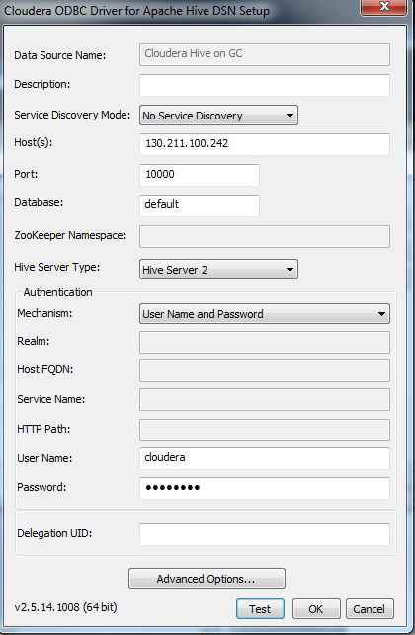
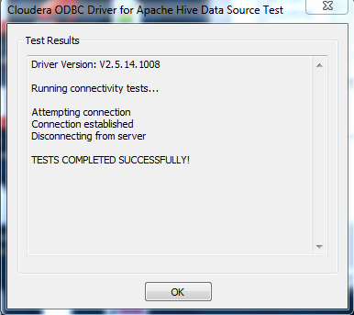
ODBC Configuration
Control Panel->Setup ODBC Data Source (ODBC)
Under System DSN-> Add
Enter the following parameters:
Host: ip address of the Hadoop box
Auth mechanism: user name & Password
Username/passwd: cloudera/cloudera
Click on Test and ensure that it returns success.

Slide 4
Omniture Analysis
Install Cloudera ODBC Driver (64 or 32 bit)
Download power BI
Code: hive-omniture.txt
ominture.pbix (power BI cached file)
Dataset: omniture

Slide 5
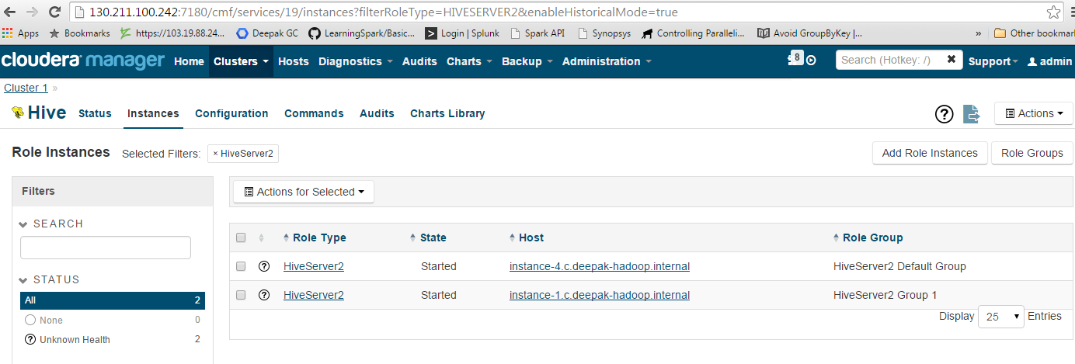
Power BI
Create a new BI Report
Get Data-> More->Other->ODBC
Under Connection String, enter the following:
Driver=Cloudera ODBC Driver for Apache Hive;Host=130.211.100.242;Port=10000; HiveServerType=2;Schema=default
(or)
DSN=Cloudera Hive on GC (the name of the DSN you created using Control Panel->ODBC)
You will be prompted for username/password:
cloudera/cloudera
Note: If you are unable to determine which IP address (amongst the cluster IP addresses) to use, then run the cloudera admin manager at port 7180 and determine the host running HiveServer2

Slide 6
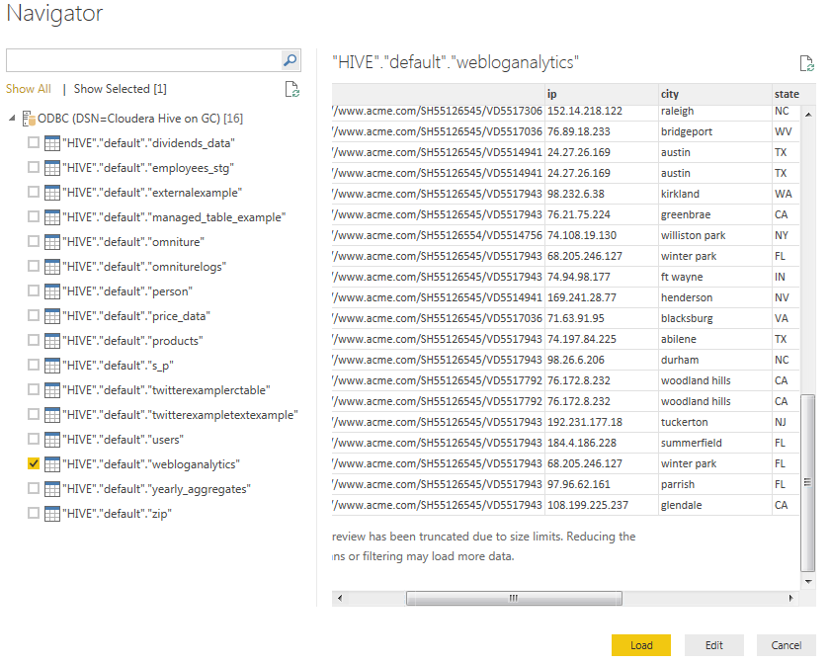
Select the Table from Hive
Note: Loading of data can take a while ……

Slide 7
Drag and Drop Charts and Fields
Create a new Measure: count(IP)
Create Charts and drag & drop columns into respective areas.

Slide 8
